Slide 1
Abstractive Text Summarization
Major project

Slide 2
B.Tech VIIIth Semester Major Project
Name | Roll No.
Khan Mohd Arquam | 17BCS008
Habibur Rahman | 17BCS071
Saman Rashid | 17BCS094
Department of Computer Engineering,
Jamia Millia Islamia

Slide 3
What is a text summarizer?
A summarizer generates a shortened version of a text, called the summary of the text.
The summary contains all the main and important points of the text.
The primary task of a text summarizer is to convert a long text to a short text which contains all the relevant information.

Slide 4
Why do we need a text summarizer?
Reduces human labour.
Saves reading time.
Helps avoid confusion in reading long and complex texts.
Easy to understand.
Enables good retention of information.

Slide 5
What are the types of text summarizers?
Text Summarizers can be broadly classified into two types:
Extractive text summarizers.
Abstractive text summarizers.

Slide 6
Extractive Text Summarizers
It is based on “Text Extraction”.
It picks up sentences/phrases from the original text.
The important information from the source text is picked.
Hence, in this type of summarization, every word and phrase of the summary generated belongs to the original text.

Slide 7
Limitations of Extractive summarizers
Extractive summarizers have the following limitations:
Since extractive summarizers use the exact same sentences/phrases as in the original text, sometimes this may generate a summary containing less important information because a part of a sentence may contain useful information, but the rest of it may be useless.
Another issue is the use of pronouns in the original text. When a certain sentence/phrase in the text containing a pronoun is included in the summary, it may be ambiguous to what the pronoun is referring to.

Slide 8
Abstractive Text Summarizers
Unlike extractive summarizers, abstractive summarizers do not select exact sentences from the original text.
This type of summarizers generate new sentences from the original text without missing any relevant/important information.
The generated summary may contain words/phrases that do not appear in the original text.

Slide 9
Abstractive Text Summarizers
These summarizers use a vocabulary set different from the original text.
These summarizers follow a similar approach as that of humans.
Humans generate a semantic representation of the text in their brains. Then they pick words from their general vocabulary to fit into the semantics and thus generate a short summary that includes all the important/relevant information.

Slide 10
Dataset Used
The dataset used contains over 3,00,000 news articles.
These news articles belong to two prominent news agencies:
CNN
Dailymail
The source of the dataset is: www.tensorflow.org/datasets/catalog/cnn_dailymail

Slide 11
Dataset Used
The distribution of the dataset will be as follows:
Testing: 10,000 articles.
Validation: 10,000 articles.
Training: Rest of the dataset (Around 2,90,000).
Also, since the number of Dailymail articles(2,19,000) is greater than the number of CNN articles(92,000), the data from both sets have been divided proportionately in the aforementioned distribution (Testing, Validation, and Training).

Slide 12
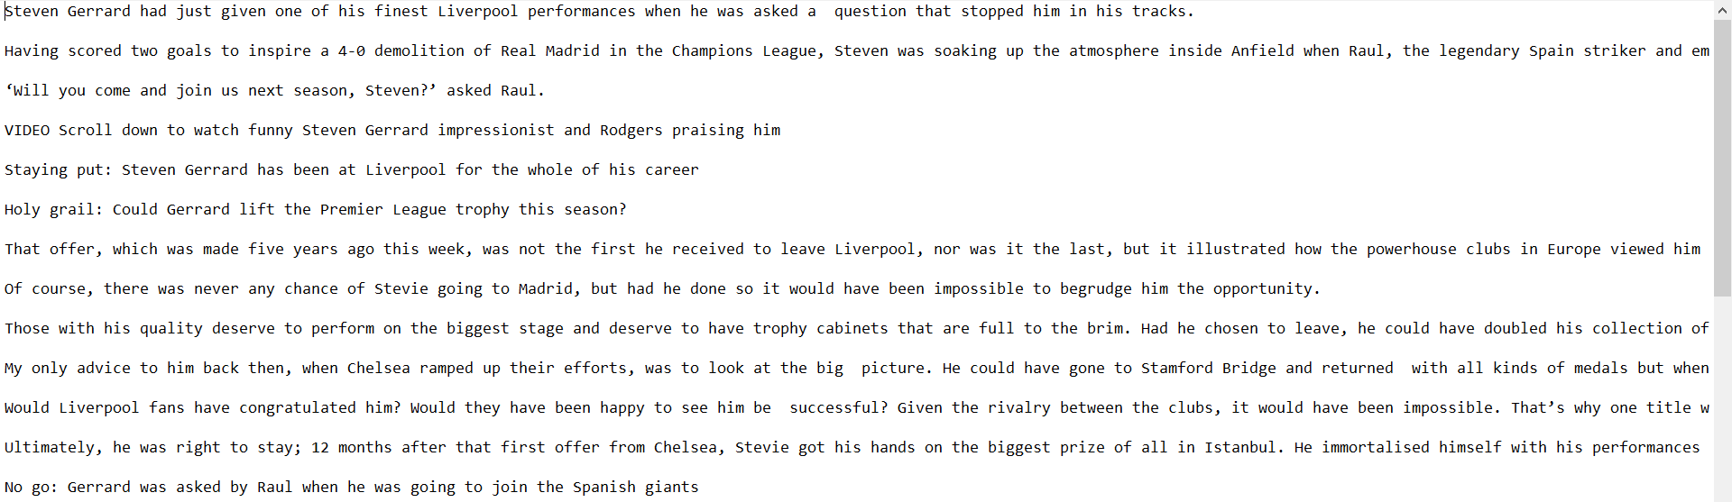
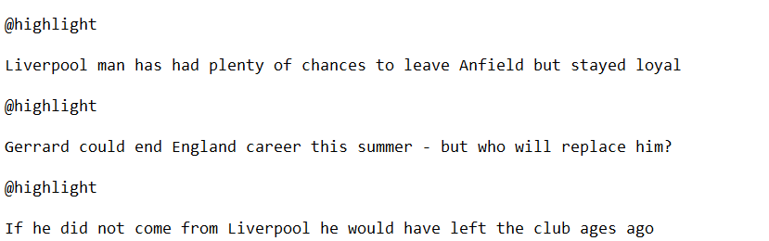
News Article:
Reference summary:

Slide 13
Data Preparation
Before using the dataset we first prepare the data to be ready for fast and efficient processing.
We first tokenize the data, then we convert our data into binary format, and then we divide the data into many files for our convenience.

Slide 14
Data Preparation: Tokenization
Since we are using Recurrent Neural Networks, we use sequential data in the form of tokens.
To generate these tokens we perform tokenization of our articles as well as reference summaries.
For tokenization, we use Stanford NLP Tokenizer which is a software that has been developed by Stanford University.

Slide 15
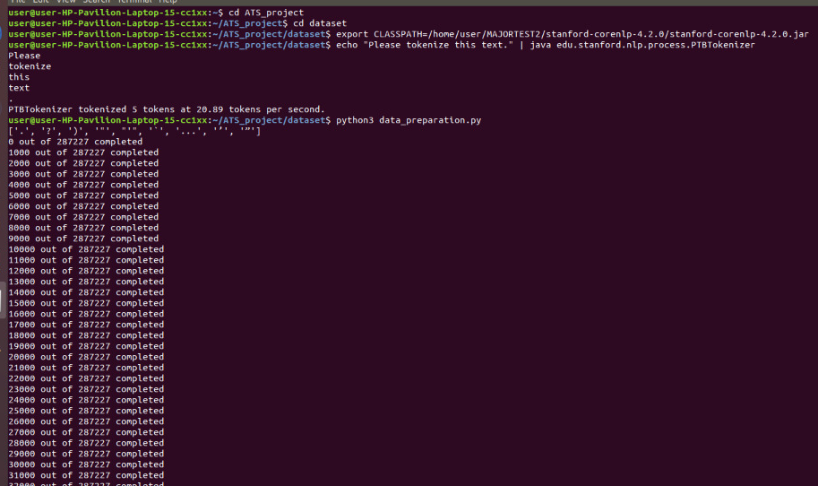
Tokenization:

Slide 16
Data Preparation: Creating vocabulary
We also count the number of time each token appears in the dataset.
With this we create a vocabulary file which list the token(word) and its frequency over the dataset.

Slide 17

After Tokenization

Slide 18
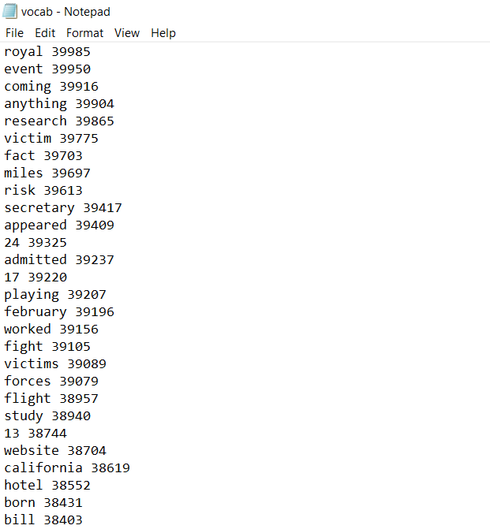
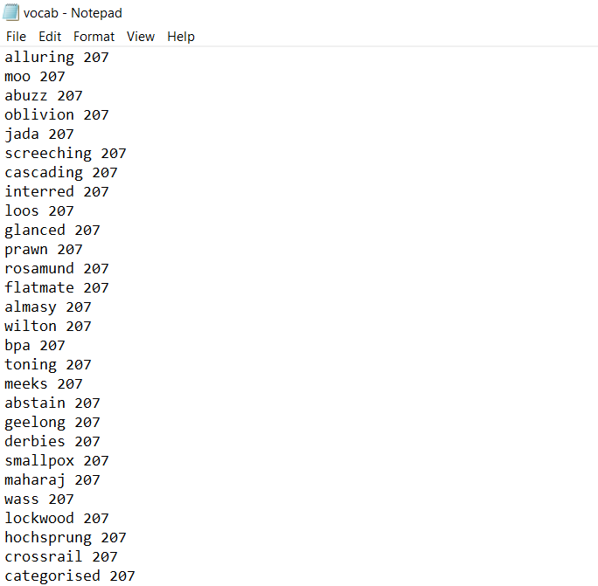
Vocabulary File

Slide 19
Data Preparation: Creating binary files
Next, we convert the tokenized files into .bin(binary) files.
This is done to enable better efficiency and speedup the training process.
We generate three files:
Train.bin
Valid.bin
Test.bin

Slide 20
Data Preparation: Diving binary files
The binary files are then divided into smaller files such that each files contains 1000 articles.
This is done for our convenience so that we can use only specific files or less data manually if required.
Thus following conversions take place:
Train.bin -> Train001.bin, Train002.bin, Train003.bin, …
Valid.bin -> Valid001.bin, Valid002.bin, Valid003.bin, …
Test.bin -> Test001.bin, Test002.bin, Test003.bin, …

Slide 21
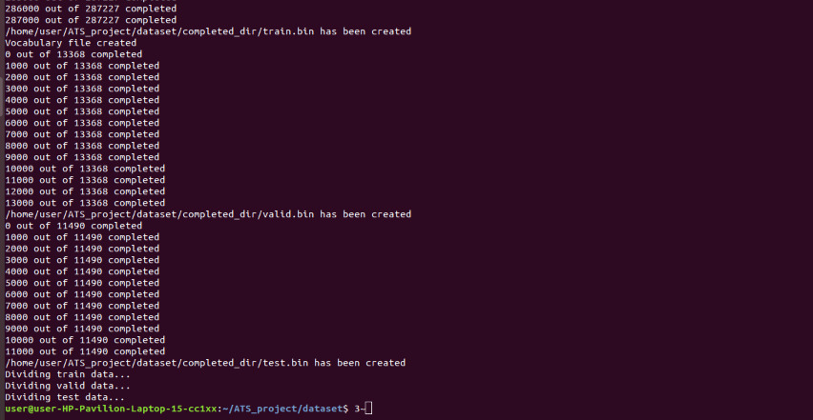
Creating .bin file:

Slide 22
Using Google Colaboratory
Since we have limited computational resources, we have used Google Colaboratory which provides us with a virtual machine via cloud computing.
In the basic version of Google Colaboratory, we get 12 hours of runtime, 12GB of RAM, 60GB of Hard disk storage, and sometimes we also get a GPU.
At present, we are training and validating the dataset on Google colaboratory.

Slide 23
Hyperparameters values:
The following are the values of hyperparameters used in our model:
Batch size= 16
Word embeddings dimension= 128
Vocabulary size= 50,000
Learning rate= 0.15
Maximum encoder steps= 400
Maximum decoder steps= 100

Slide 24
Creating Batches
Before training step, we create batches of the data.
The batch size means the number of articles that will be processed in one iteration.
We have taken batch size of 16.
We change the size of all articles to the size of the maximum article size by padding the blank spaces.

Slide 25
Creating Tensorflow Model
Tensorflow is a library in python which enables us to build machine learning models.
We created a tensorflow model for our summarization training and validation.
This model is training the dataset to generate weights and thus give us the optimal text summarizer.

Slide 26
Creating Tensorflow Model
First we added tensorflow placeholders like encoder batch, encoder length, decoder batch, target batch, decoder length, padding masks.
Next we added a bidirectional LSTM encoder to the graph using the function: tensorflow.nn.bidirectional_rnn(). This gives us forward and backward state.
Next we added a linear layer to the graph, which enables reducing forward and backward states into a single state.

Slide 27
Creating Tensorflow Model
Next, the encoder state, padding mask, RNN cells, and coverage vector were fed into the decoder.
Now according to formula,
e^{t}_{i} = v^{T} tanh( W_{h}h_{i} + W_{s}s_{t} + b_{attn})
a^{t} = softmax( e^{t} )
Where v, W_{h}, W_{s}, and b_{attn} are learnable parameters and h_{i} is the encoder state.
In this way the attention distribution was generated.

Slide 28
Creating Tensorflow Model
Now, we generated the context vector which is the weighted sum of the encoder state according to the attention distribution.
Next using the context vector, we find the vocabulary probability distribution:
P_{vocab} = softmax (V’ (V[s_{t}, h_{t}*]+b)+b’)
Where V’, V, b, and b’ are learnable parameters.

Slide 29
Creating Tensorflow Model
After that we calculated the word generation probability,
p_{gen} = sigmoid(w_{h}^{T} h_{t}* + w_{s}^{T} s_{t} + w_{x}^{T} x_{t} + b_{ptr} )
Where w_{h}, w_{s}, w_{x}, and b_{ptr} are learnable parameters.
And finally, we get the probability distribution of the word to be generated,
P(w) = (p_{gen}*P_{vocab} (w)) + ((1 - p_{gen}) * ∑a^{t}_{i})

Slide 30
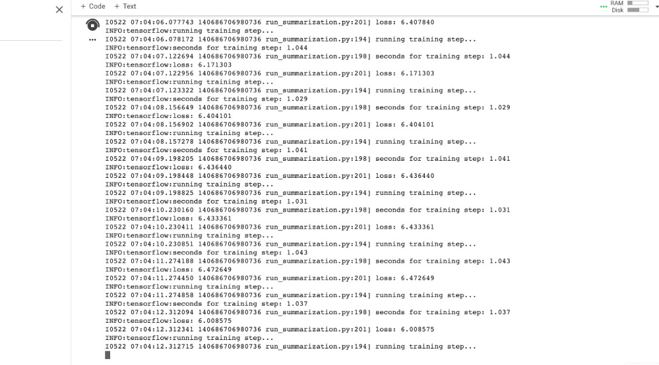
Training Process (at start):

Slide 31
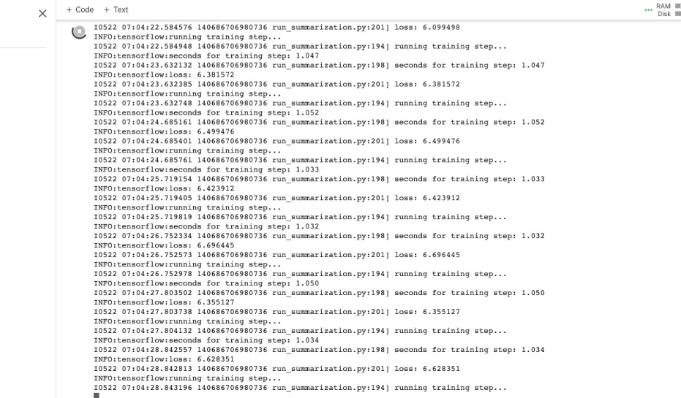
Training Process (after 10 min):

Slide 32
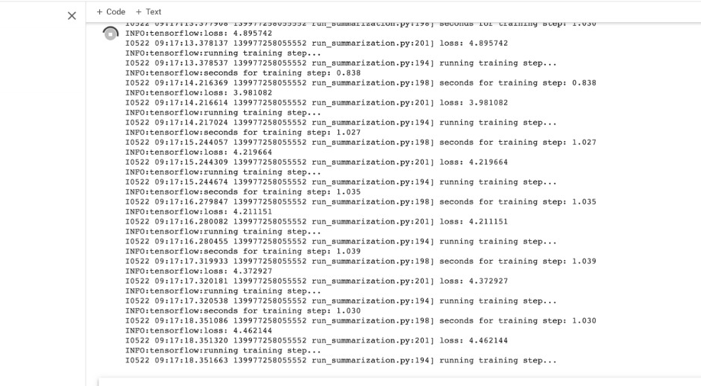
Training Process (after 4 hrs):

Slide 33
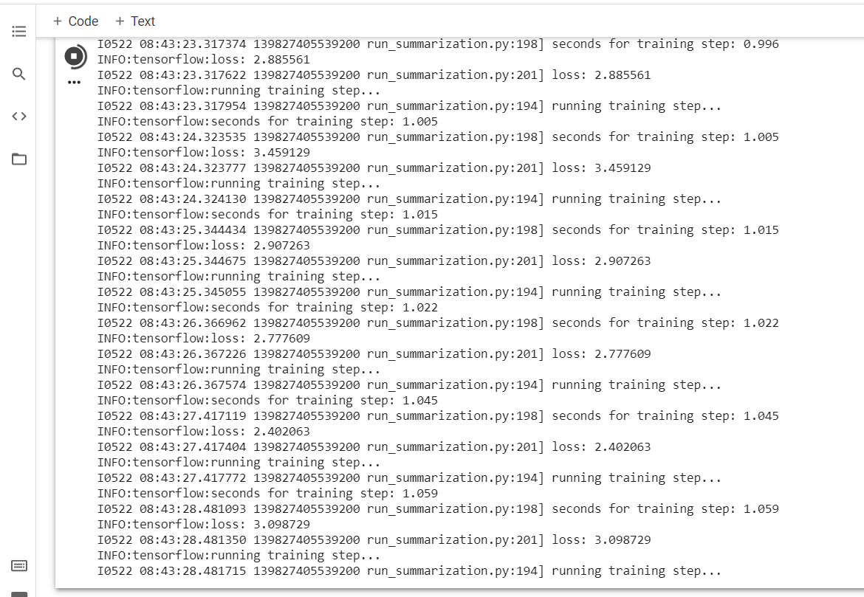
Training Process (after 1 week):

Slide 34
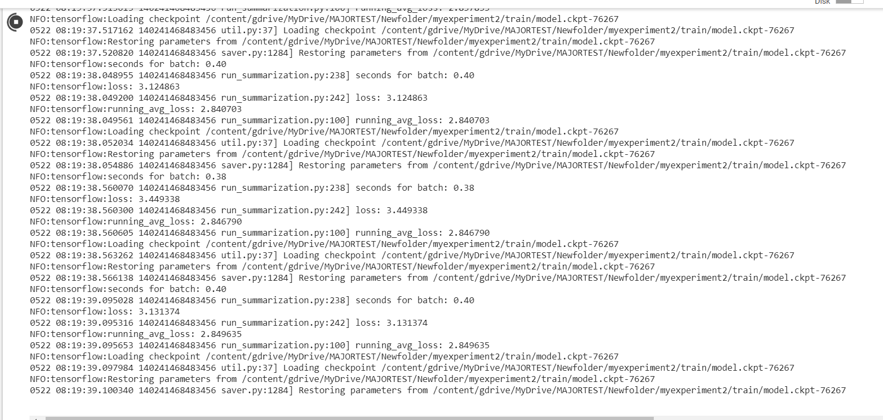
Validation Process:

Slide 35
Remaining Work
To create file for decoding by using beam search algorithm.
To visualize the metrics such as loss, and to visualize the tensorflow graph. This will be done using tensorboard.
To create testing file which will test the model and evaluate it based on ROGUE scores.
To create a web application, wherein user can enter news articles to get summary of that particular article.

Slide 36
Programming Environment and Tools Used
Programming Language: Python3
Libraries Used: Tensorflow, Numpy
Operating System: Windows 10, Linux
Software Tools: Jupyter Notebook, Anaconda, Google Colaboratory
Technology: Machine Learning and Natural Language Processing

Slide 37
References
“Just News It: Abstractive Text Summarization with a Pointer-Generator Transformer” : Vrinda Vasavada, Alexandre Bucquet.
“Neural Abstractive Text Summarization with Sequence-to-Sequence Models” : TIAN SHI, YASER KENESHLOO, NAREN RAMAKRISHNAN, CHANDAN K. REDDY.
“Get To The Point: Summarization with Pointer-Generator Networks” : Abigail See, Peter J. Liu, Christopher D. Manning.
“Abstractive sentence summarization with attentive recurrent neural networks.” : Sumit Chopra, Michael Auli, Alexander M Rush.
“NEURAL MACHINE TRANSLATION BY JOINTLY LEARNING TO ALIGN AND TRANSLATE”: Dzmitry Bahdanau, KyungHyun Cho, Yoshua Bengio
Dataset: www.tensorflow.org/datasets/catalog/cnn_dailymail

Slide 38
Thank You

